Slide 1
Graphic Forms

Slide 2
Purpose:

Slide 3
Clarity
The purpose of a chart is to bring clarity to the data. Nothing more.

Slide 4
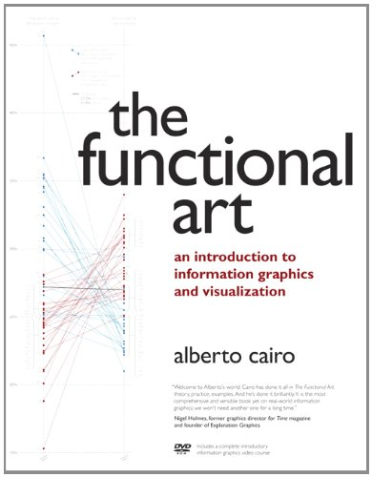
Functional Art
Alberto Cairo

Slide 5
Are infographics art?

Slide 6
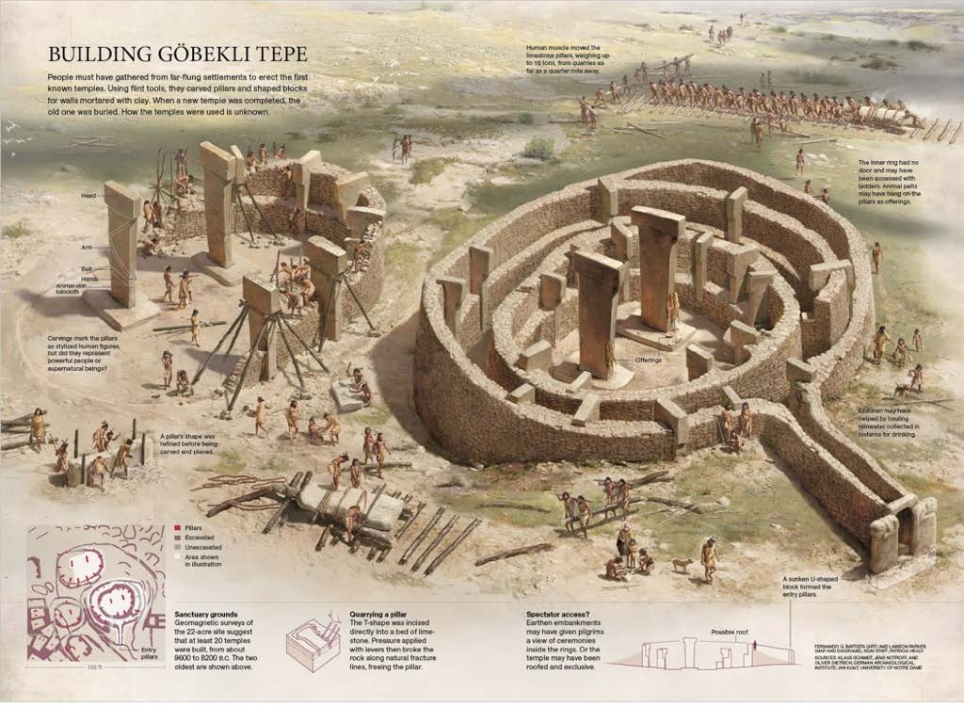

Slide 7
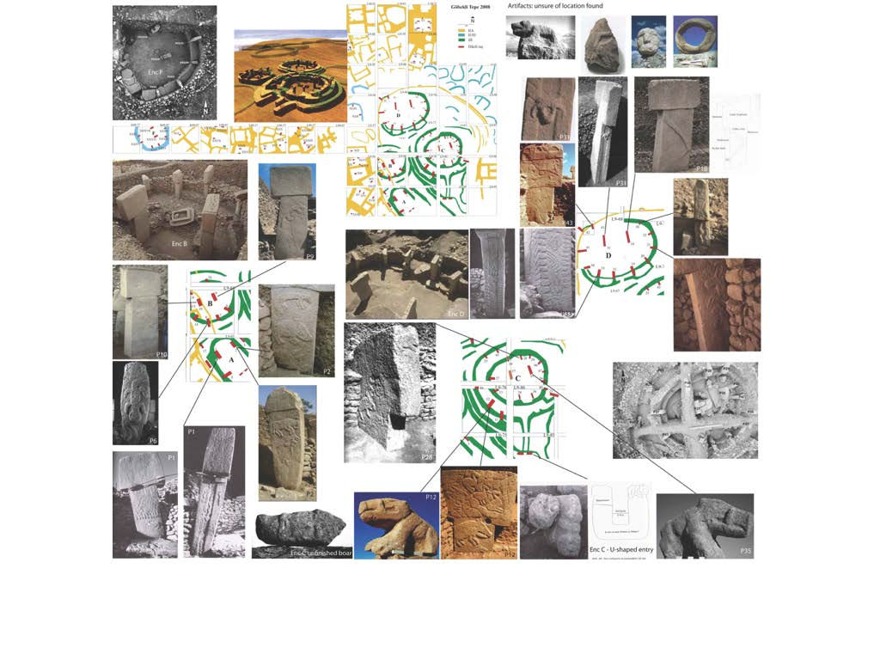

Slide 8
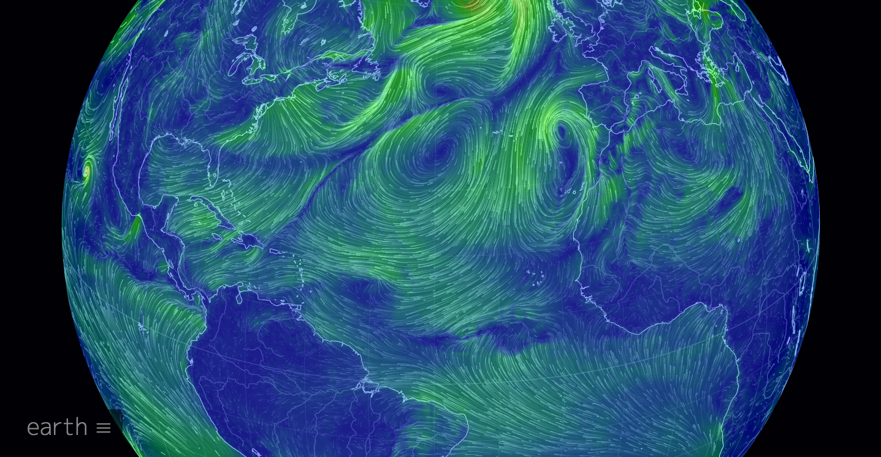

Slide 9
Are infographics news?

Slide 10
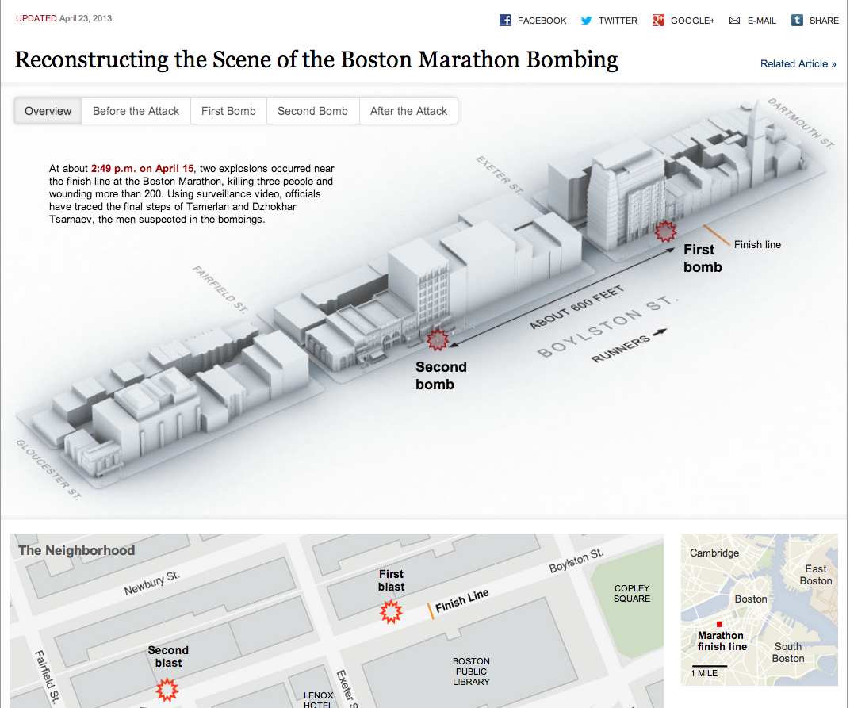
http://www.nytimes.com/interactive/2013/04/17/us/caught-in-the-blast-at-the-boston-marathon.html?ref=us

Slide 11
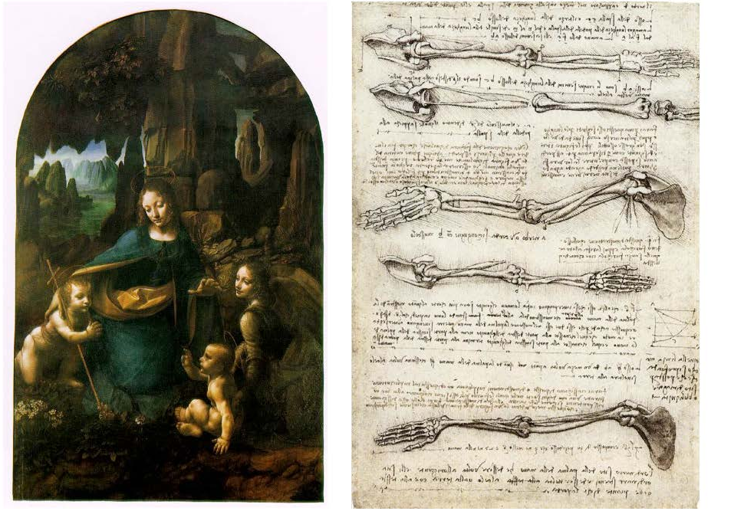
What is the difference between art and functional art?

Slide 12
Art?
Thinking that infographics are just ‘art” leads to wrong priorities.

Slide 13
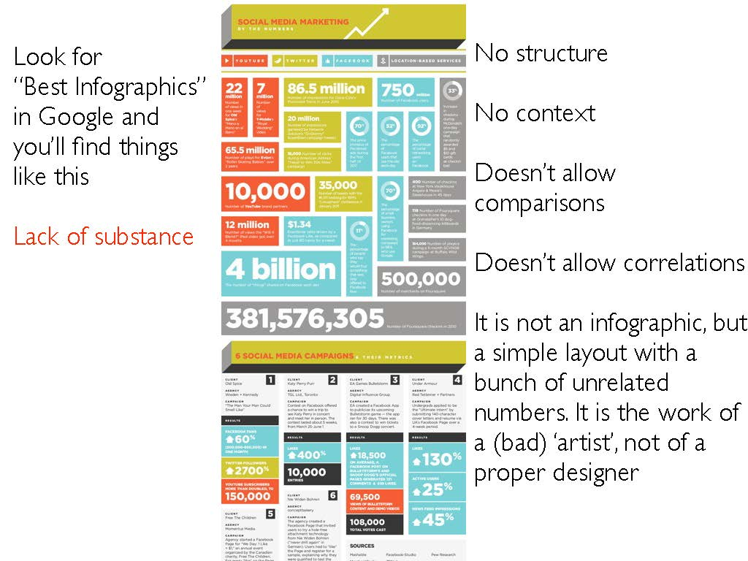

Slide 14
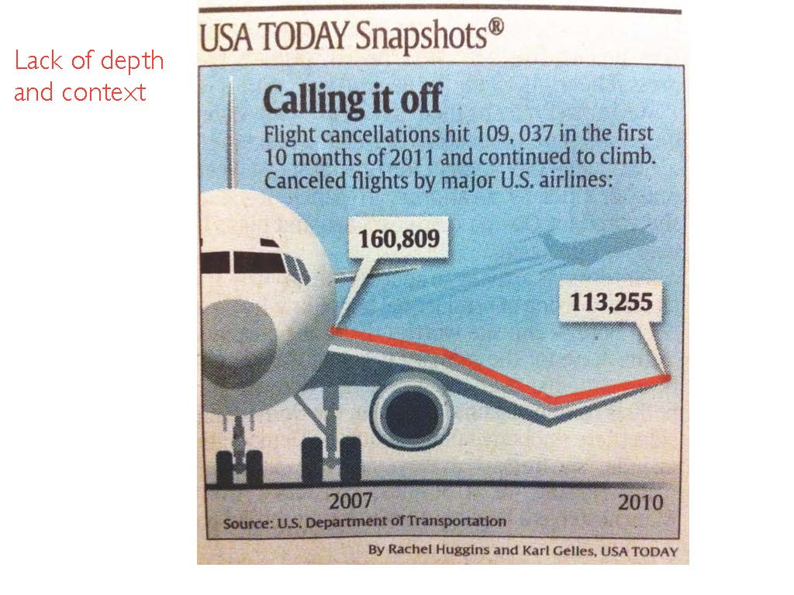

Slide 15
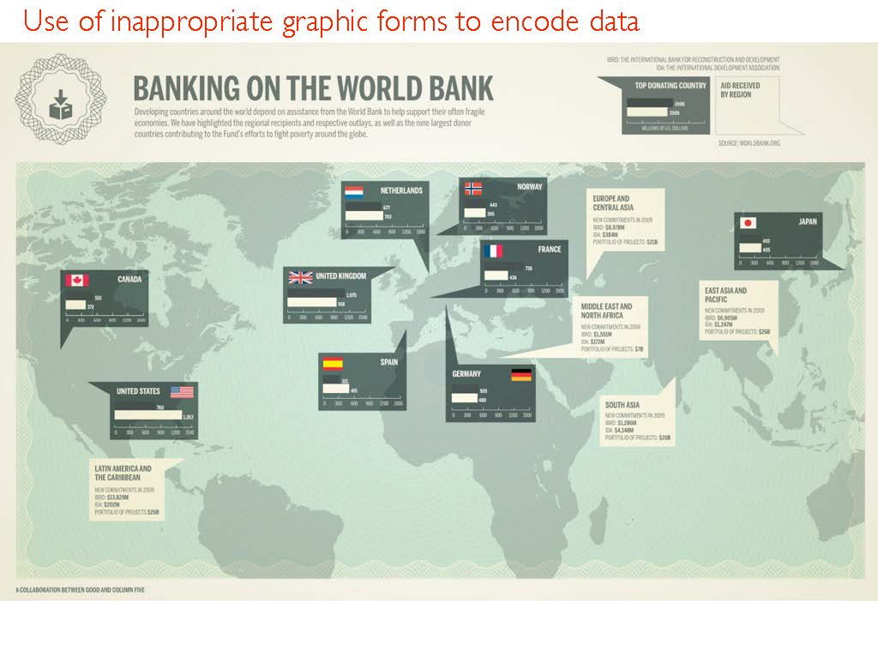

Slide 16
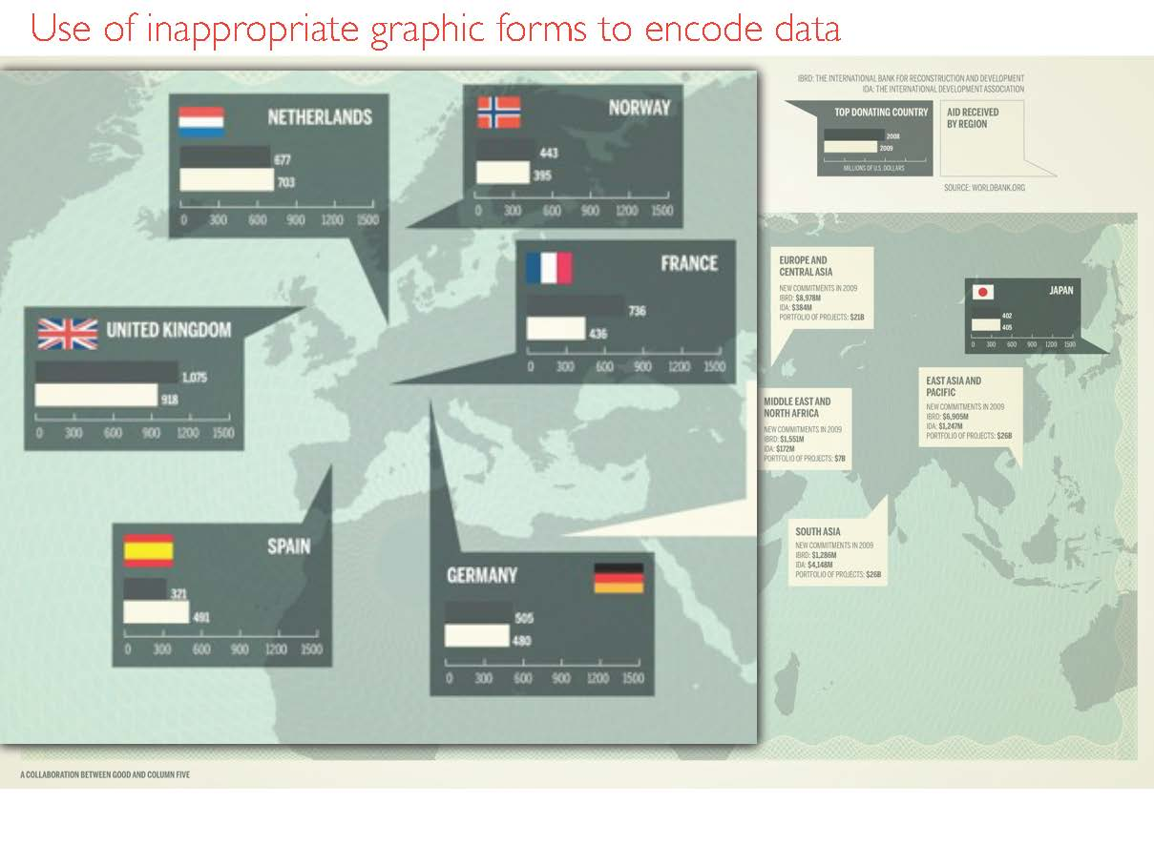

Slide 17
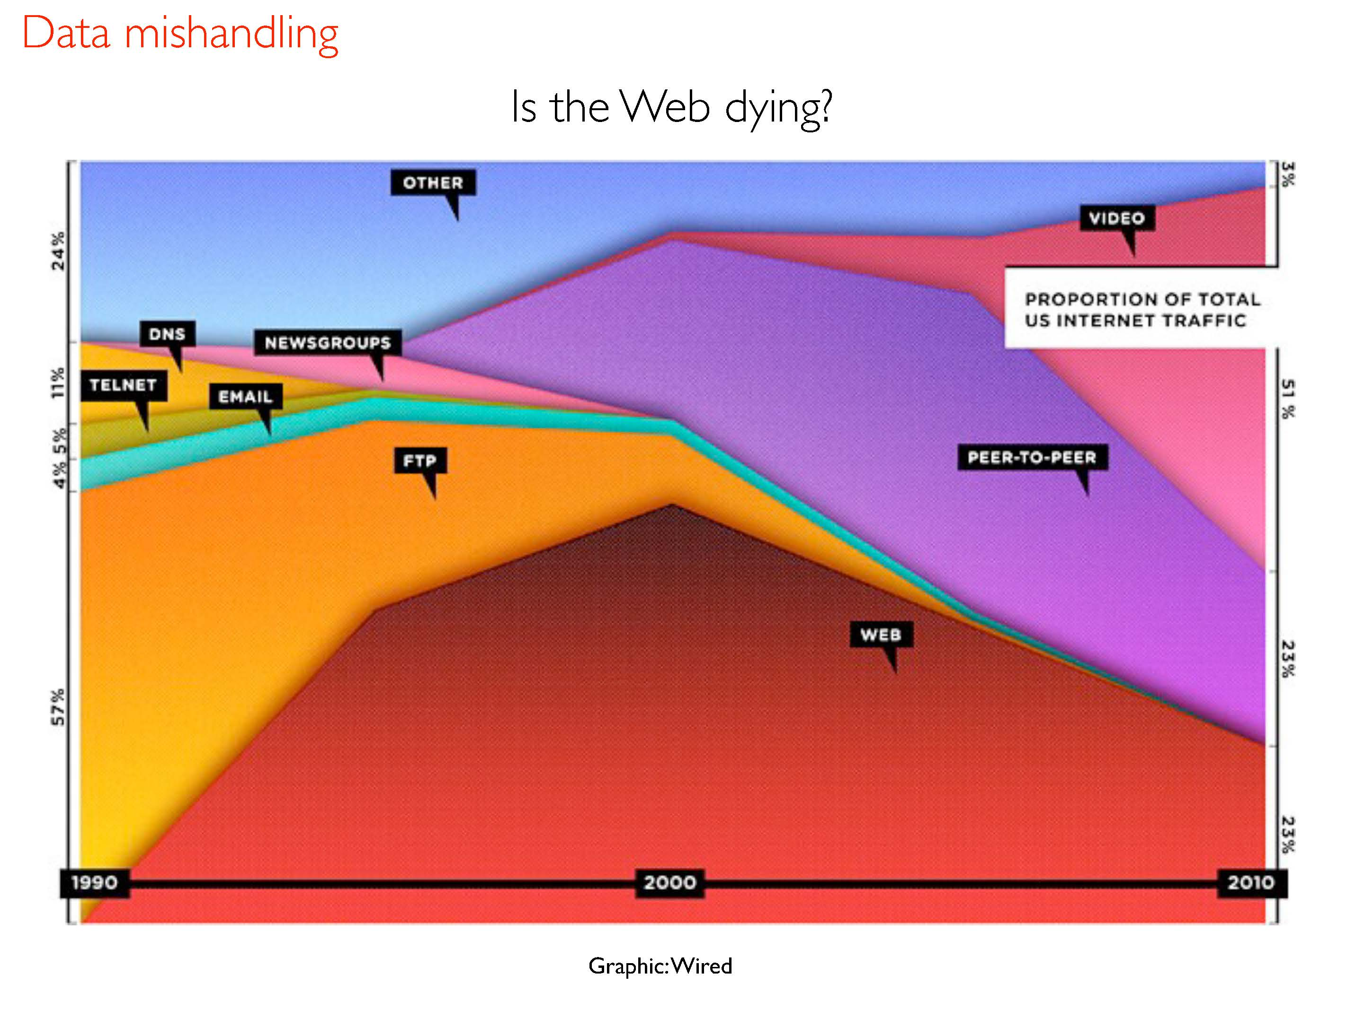

Slide 18
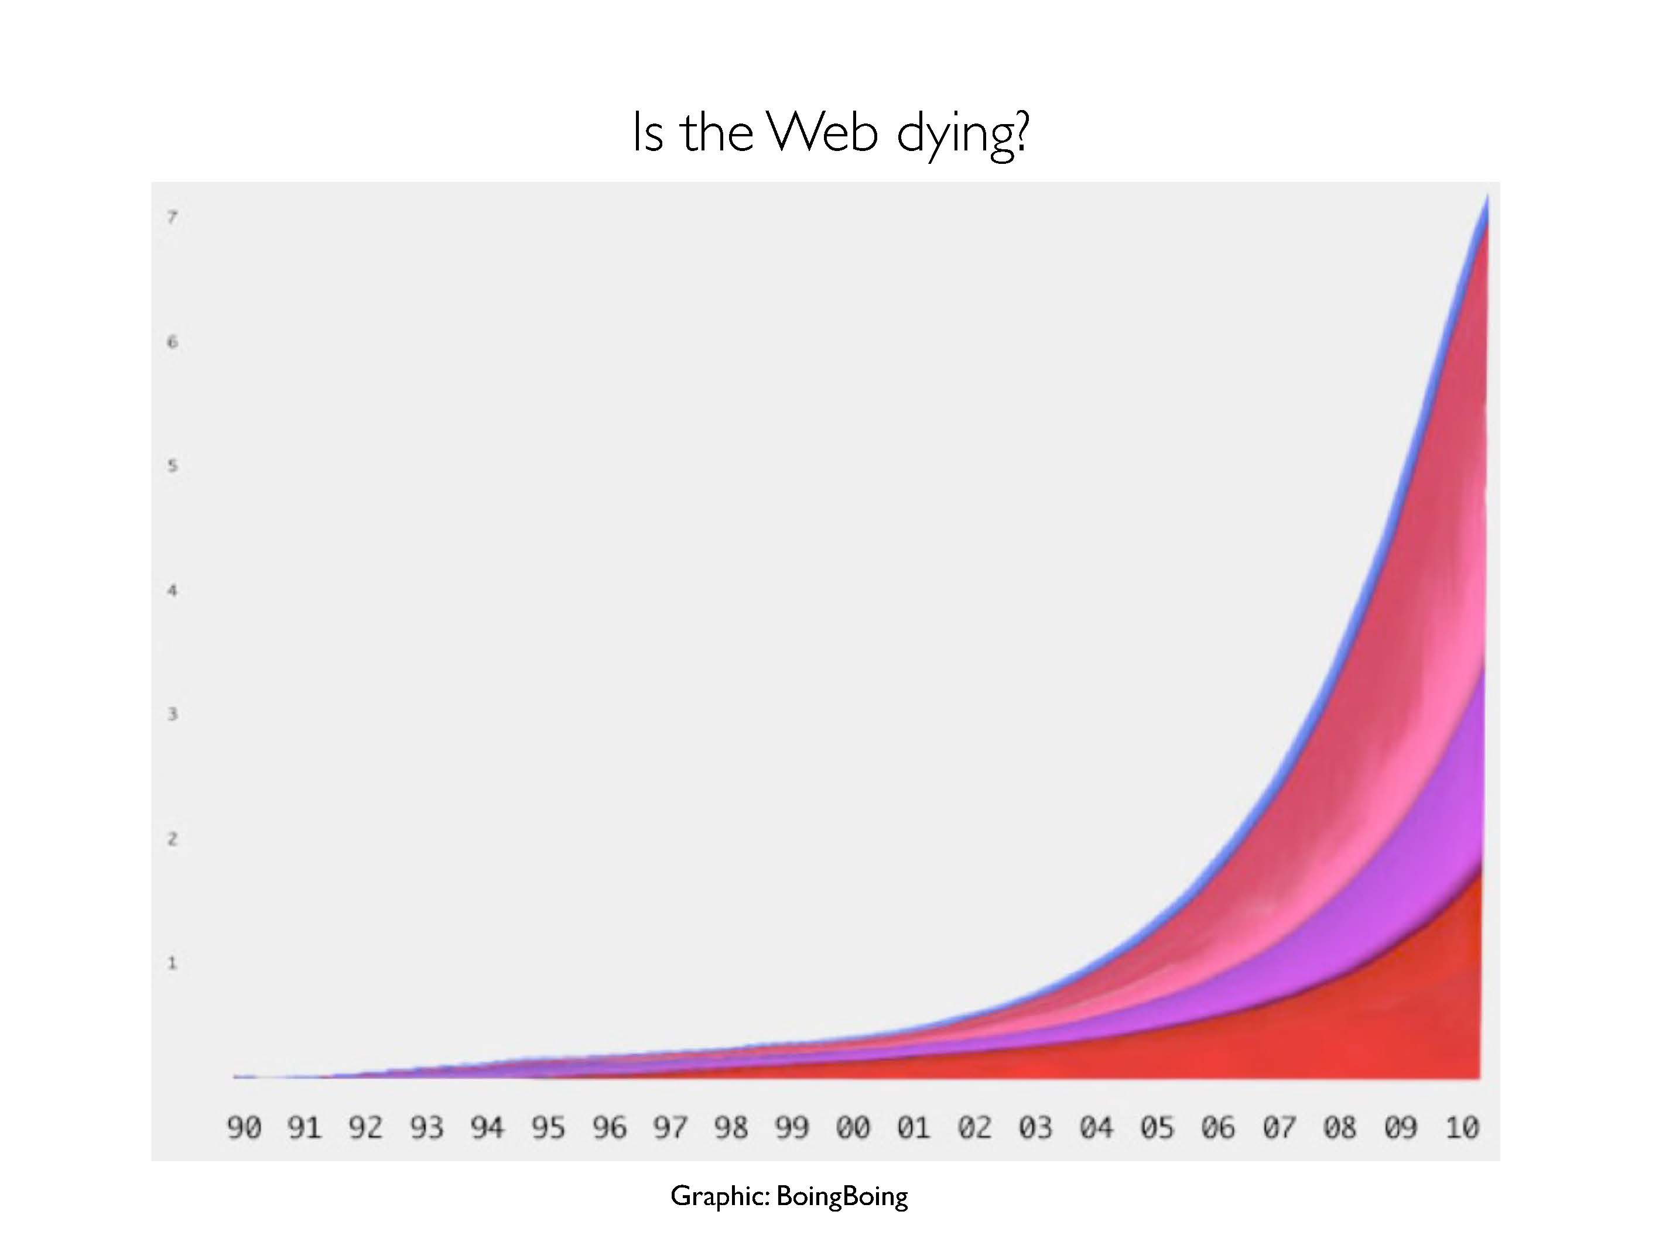

Slide 20
Learn from History
It’s important but I am going to go quick!

Slide 21
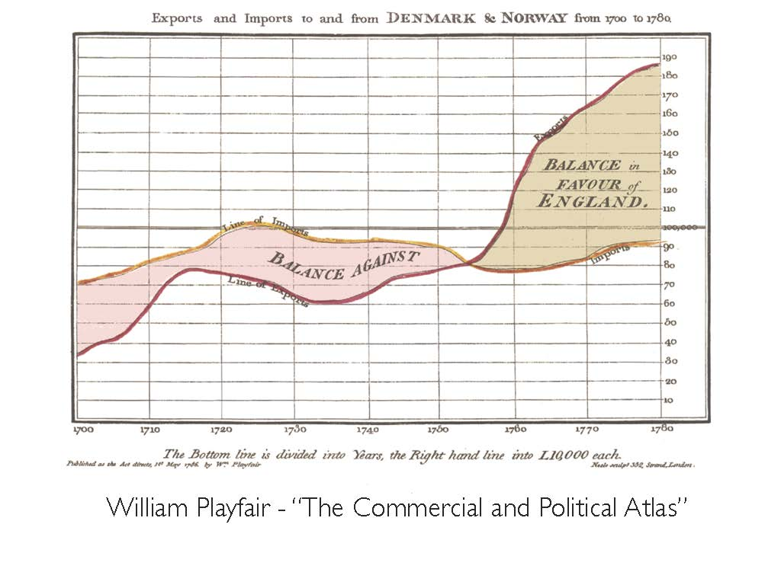
1776

Slide 22

1854

Slide 23
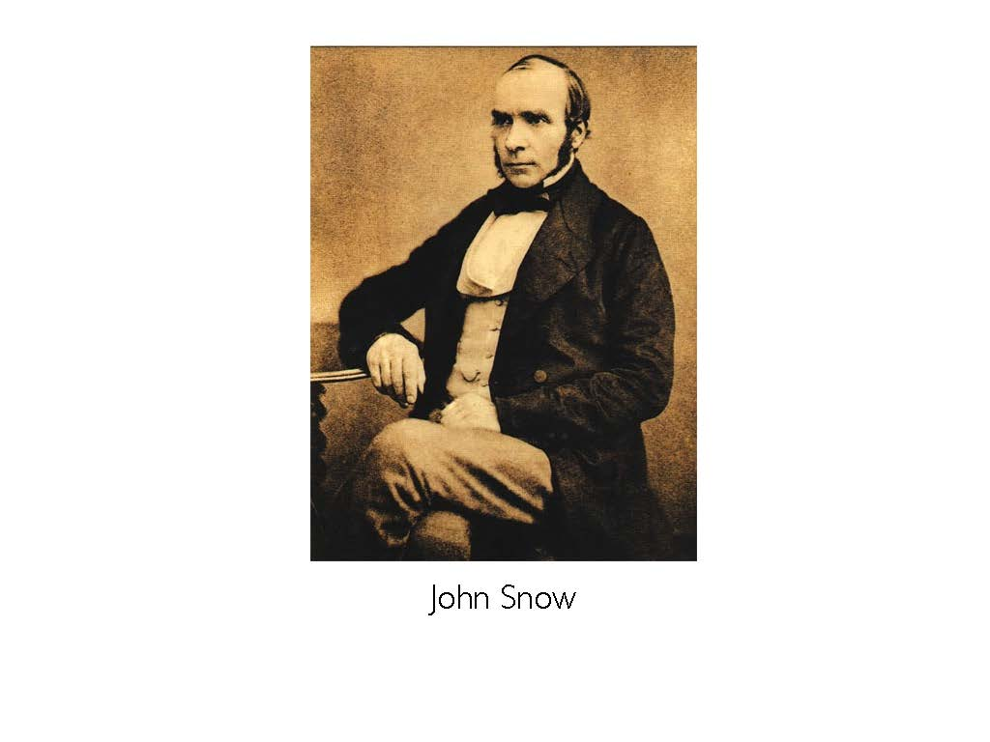
John Snow
Notes:
Snow used this spot map to illustrate how cases of cholera were centred around a water pump. This helped to show that cholera was being spread through the water, and not by air as was thought at the time. - See more at: http://visual.ly/john-snow-cholera-map#sthash.RPw8YjAu.dpuf

Slide 24
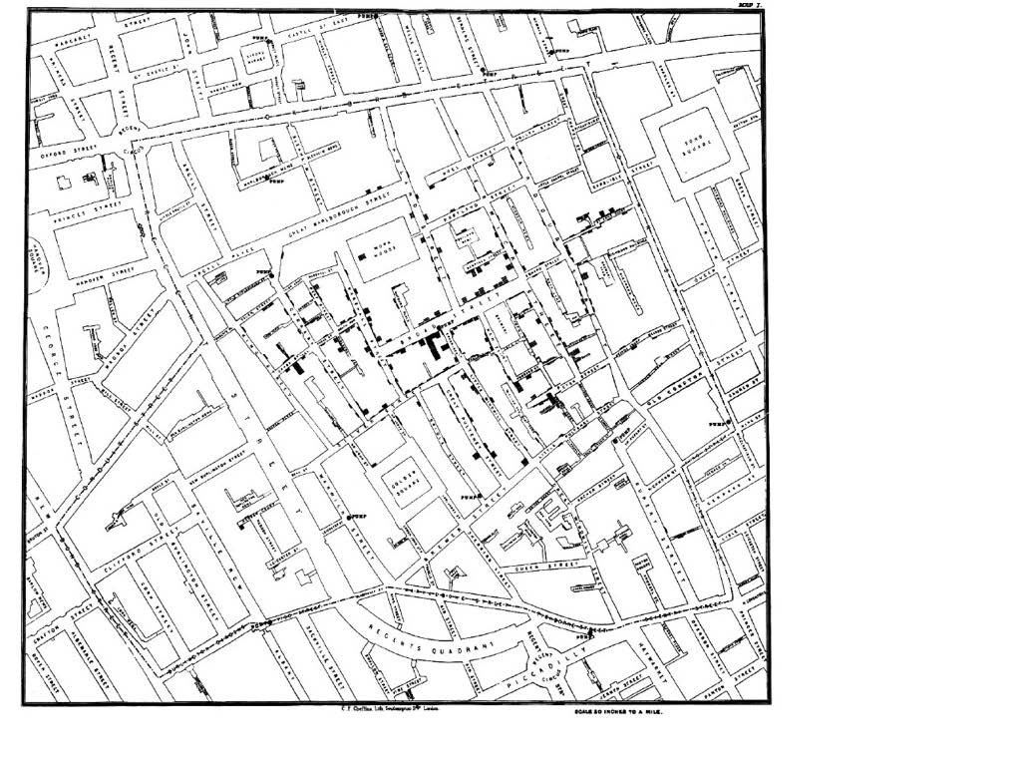

Slide 25
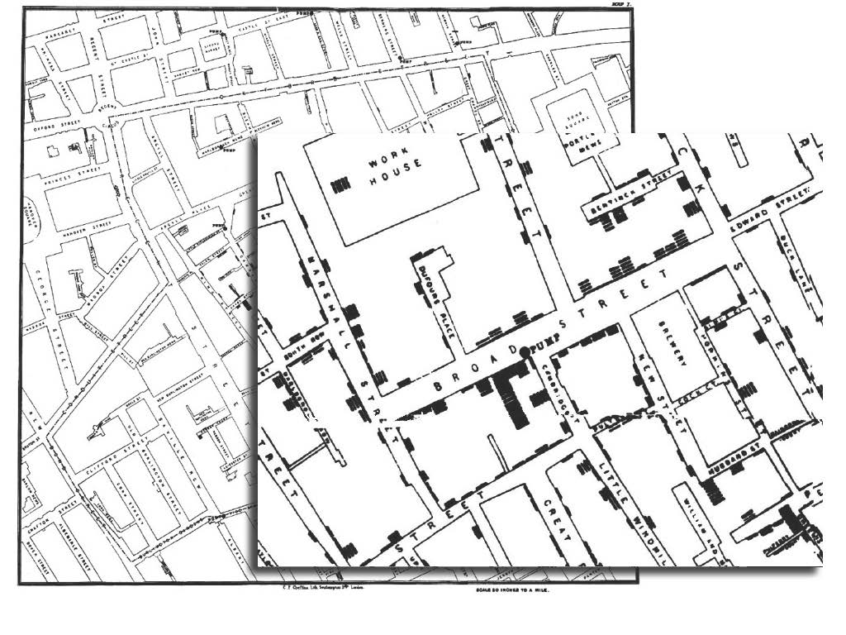

Slide 26
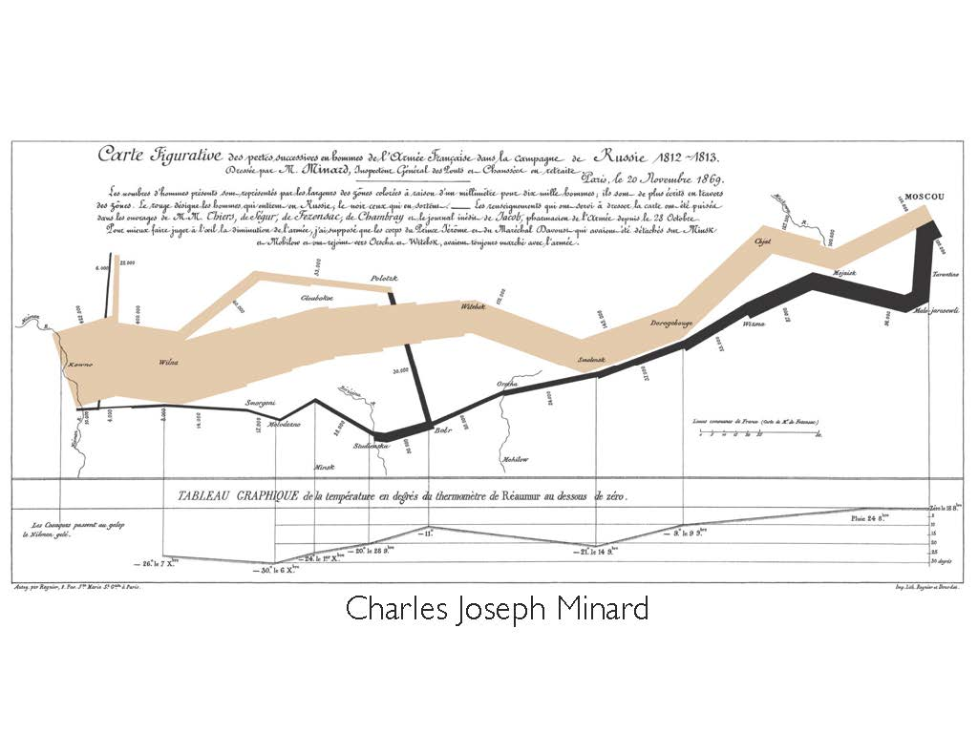
1869
Notes:
First flow map. Napalon’s disaster taking Moscow.

Slide 27
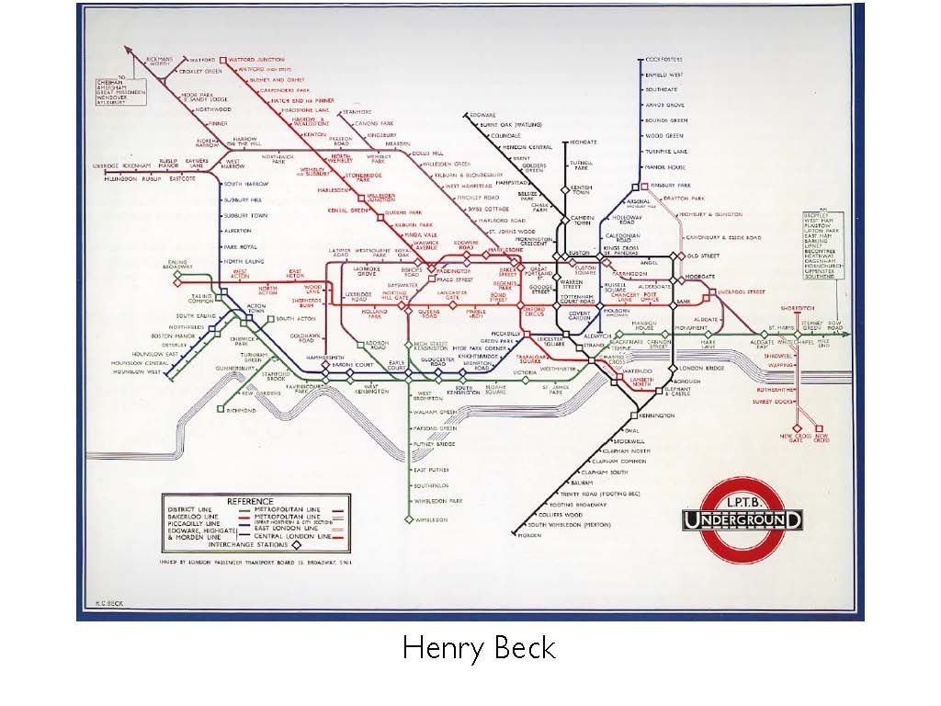
1933

Slide 28
Chart Types
Remember, to provide clarity.

Slide 29
1. Bar or Column Chart
Most common chart because it is quick to compare information reveling highs and lows.
When to Use
Comparing data across categories.
Examples:
Volume of shirts in different sizes
Website traffic by origination site
Percent of spending by department.
Tips:
Add color to bars for more impact
Use stacked bars or side-by-side bars for depth
Use Both sides of the axis for comparison

Slide 30
2. Line Chart or Fever lines
Very common chart because it is quick to see trends
When to Use
Comparing data over time
Examples:
Stock price change over a five- year period
Website page views during a month
Costs by quarter.
Tips:
Add color to lines for more impact
Combine with bar charts for comparison
Share Space to show volume

Slide 31
3. Pie Chart
Very common chart but overused often.
When to Use
Relative Proportions
Percentages of totals
Examples:
Percentage of budget spent by department
Website visitors by browser
Costs by category
Tips:
Must show differences and be obvious
Not too many categories
Try overlays and extra data for clarity

Slide 32
4. Maps
Show location data
When to Use
Show data and the location
Examples:
Reports by State
Website visitors by county or country
Accidents by Zip code
Tips:
People must know the location
Simplify when possible
Try overlays and layers of data for clarity

Slide 33
5. Scatter Plot
For deeper, complex data
When to Use
To give sense of trends, concentrations and outliers
Examples:
technology early adopters’ and laggards’ purchase patterns of smart phones
Tips:
Must show differences
Carful, not too much
Must be the right data

Slide 34
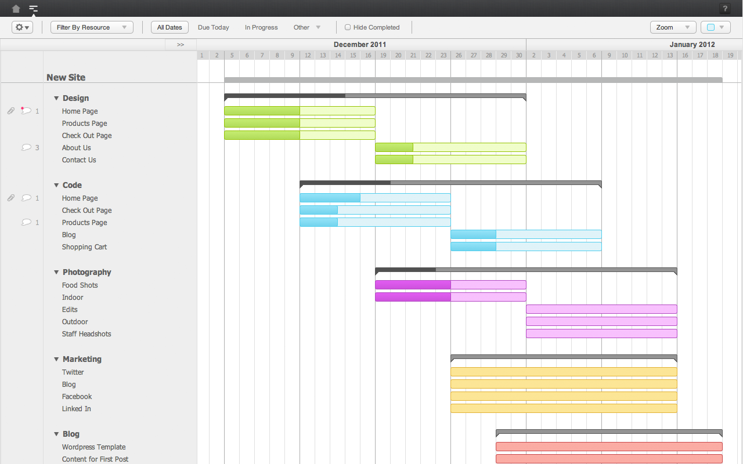
6. Gantt Chart
Good for illustrating the start and finish dates
When to Use
To show how tasks are related to a single project.
Examples:
Project Schedule
Tips:
Time only
Use colors and shading

Slide 36
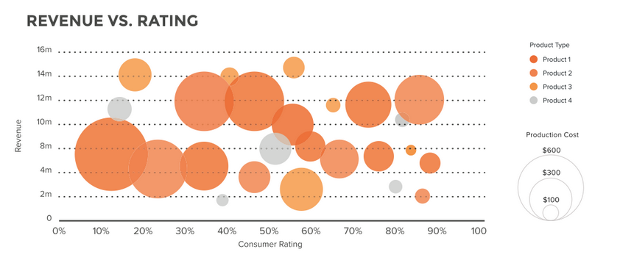
7. Bubble Chart
Used with maps and scatter plots.
When to Use
To show accentuate data
Examples:
class attendance by department and time of day
Tips:
Humans have trouble with comprehending the area of a circle so use with caution.

Slide 37
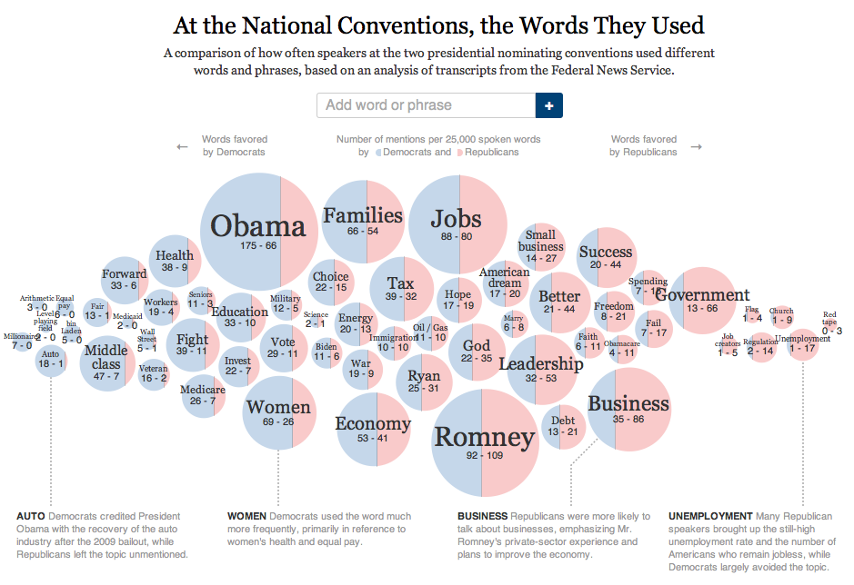

Slide 38
8. Heat Maps
Compare data across two categories using color
Examples:
segmentation analysis of a region.
Tips:
Shading works better than different colors..

Slide 40
9. Treemaps
Shows how different pieces relate to the whole. A series of rectangles, nested within other rectangles
Show hierarchical data as a proportion to the whole
Examples:
storage usage across computers
Tips:
Color rectangles by a category

Slide 41
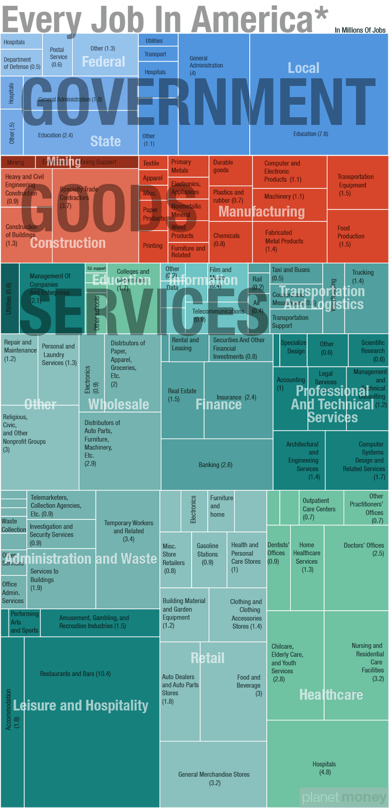
9. Treemaps

Slide 42
10. Data Tables
Compare information quickly on multiple levels
Shows differences and similarities
Examples:
Hurricanes over time,
Tips:
Make it clean and simple with colors.

Slide 43
Goal is Clarity: Remove to Improve
Darkhorse Analytics
https://speakerdeck.com/cherdarchuk/clear-off-the-table

Slide 44
Truth and Clarity
Vis and mislead intentionally and unintentionally.

Slide 45
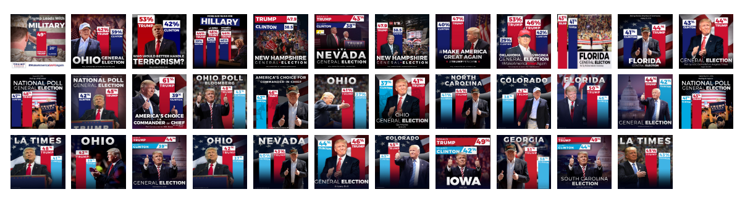
Truth in Scale

Slide 46
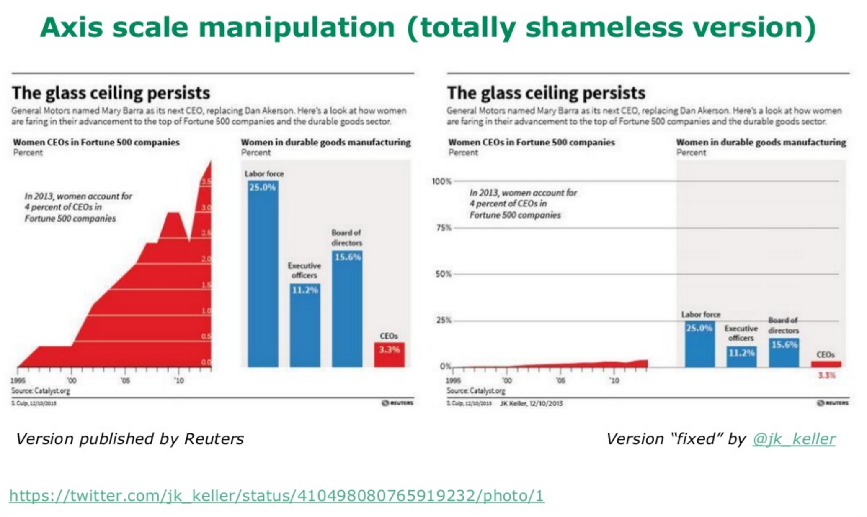

Slide 47
Women in Workplace (Another Way)

Slide 48
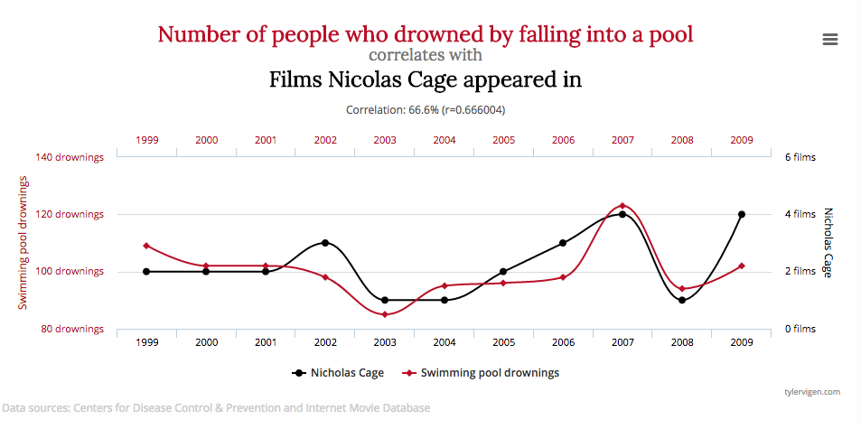
Truth in Observations

Slide 49
Correlation != Causation

